Slide 1
A PRESENTATION ON CREDIT CARD FRAUD DETECTION
Presented By:
Name : Avinandan Bose
Roll No.: 434120010019
Name: Debasish Ghosh
Roll No.:434120010022
Sec/Course: MCA (2020-2022)
Year: 2nd
Semester : 3rd

Slide 2
WHY CREDIT CARD FRAUD DETECTION?
Credit Card Fraud Detection is one of the hottest topic.
It is also used in research work , and financial sector.
It is valid in todays world as e-commerce and on-line transaction is increasing.
It is a type of data analysis to analyze the probability of fraud and generate report.

Slide 3
WHEN CREDIT CARD FRAUD OCCURS?
Un authorized charges to credit card
Counter freight cards used.
Credit card details known to others.
Online payment does not require physical cards.
Card Lost or Stolen.

Slide 4
HARDWARE REQUIREMENTS FOR THE ANALYSIS
Pentium i3 or higher(Better to start with i5 ).
4 GB RAM (Better to start with 8gb ram ).
20 GB Hard Disk Drive .
Monitor, Mouse and Keyboard.

Slide 5
SOFTWARE REQUIREMENTS FOR THE ANALYSIS
Operating System : Windows 8/10
IDE Tool : Jupyter notebook.
Coding Language : Python 3.8
Tools : Numpy, Matplotlib, Seaborn, Pandas,Scikit-learn etc.

Slide 6

DATA ANALYSIS OF CREDIT CARD DATASET.
In data set when a class is ‘0’ the transaction is non fraudulent and ‘1’ means transaction is fraudulent.
We view such classes in our data set by:
Figure: Class Frequency

Slide 7
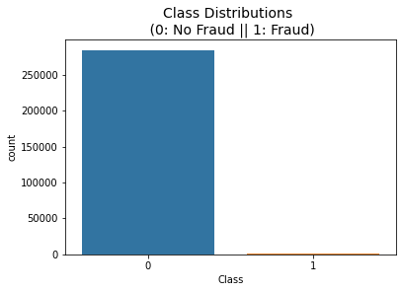
DATA ANALYSIS OF CREDIT CARD DATASET.
What is an imbalanced dataset?
An imbalanced dataset is when one ouput class has extremely high entries compared to the other output class. In this case , the positive class, i.e. , the fraudulent transaction class , has a few entries compared to the non-fraudulent/normal transaction class. So, the positive class(i.e., frauds) only accounts for 0.172% of the total transactions.

Slide 8
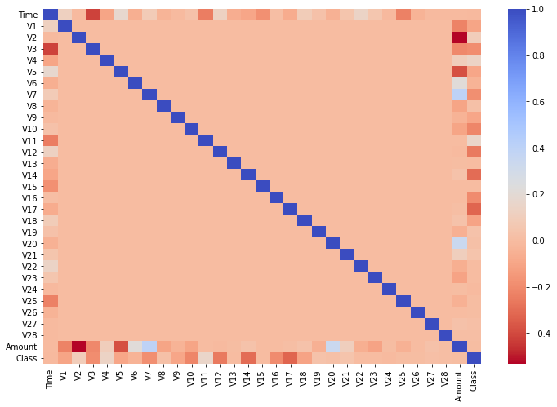
DATA ANALYSIS OF CREDIT CARD DATASET.
We will try to see a correlation plot with a heat-map to figure out the highly correlated and non-correlated and non-correlated features.
Here red is negatively correlated, and blue is positively correlated, and peach represents not correlated.
Figure: Correlation of heat map

Slide 9
DISCUSSION OF TOPIC IN PRESENTATION
SCALING
Re-Sampling
Data Re-analysis
Model training and Report

Slide 10
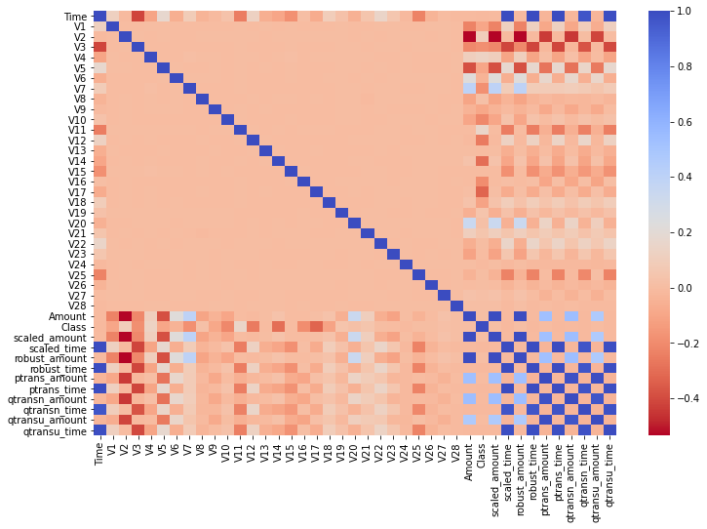
SCALING
Scaling is a method used to normalize range of independent variables or features of data .
Scaling is done for data normalization and data pre-processing.
We have applied Standard Scaler , Principal Component Analysis, Robust Scaling , Power Transformer, Quantile Transformer and Mini-Max scaling to the dataset.
Fig: Correlation heat map after applying all scaling algorithms.

Slide 11
RESAMPLING
Resampling is a technique to handle imbalance data by creating sub-sampled dataset.
Subsampling is a method that reduces data size by selecting a subset of the original data.
Under sampling is a technique to balance uneven datasets by keeping all the dataset by keeping all of the data in the minority class and decreasing the size of the majority class. Over Sampling randomly selecting dataset from the minority class, with replacement, and adding them to the training dataset.
We have used random under sampling, random over sampling , Tomek’s Links under sampling, Synthetic minority over-sampling technique to the dataset.

Slide 12
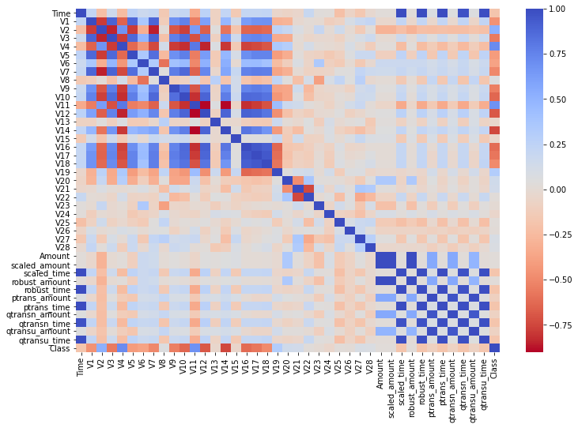
RANDOM UNDER SAMPLING
We can see V2,V4,V11 and V19 are positively correlated and V17, V14, V12, V16 and V10 are negatively correlated.
Fig: Correlation for Random Under Sampled data.

Slide 13
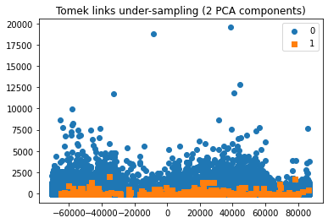
TOMEK LINKS UNDER SAMPLING
We only have 62 records like that which can be removed from the dataset.
As this is a small number of Tomek’s link, we can remove them so that other algorithms can work better if their algorithms have some effect due to those links.
Fig: PCA plot for Tomek’s Link.

Slide 14
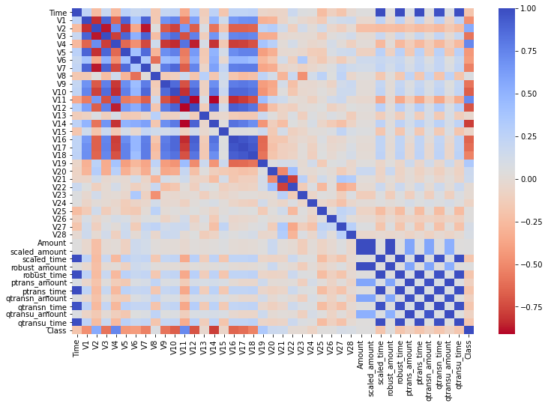
SYNTHETIC MINORITY
OVER-SAMPLING
Interestingly, we can see a similar heat map for Random Oversampling and SMOTE.
Fig: Correlation Heat map for SMOTE dataset.

Slide 15
DATA REANALYSIS
In data reanalysis we have analyzed positive and negative features of the data.
Positive features of Under sampling and Over sampling also Negative features of Under Sampling and Over Sampling.
Again we have reanalyzed Scaled Features on basis of Amount and Time.
Through these analyzing we are able to select the exact model to use in model training.

Slide 16
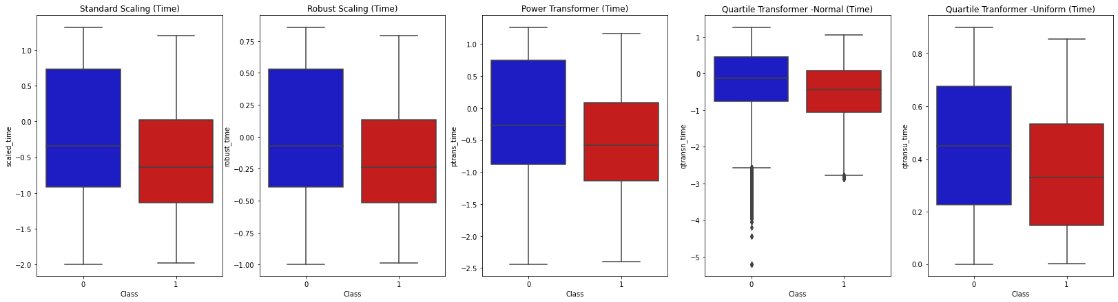
DATA REANALYSIS
Finally we will have four dataframe to run all the models.
SMOTE Dataset 1 - Robust Scaled Time, Robust Scaled Amount , V2, V4,V11, and V19(Positive), V17,V14,V12, V16 and V10(Negative).
SMOTE Dataset 2 - Power Transformer Time, Power Transformer Amount , V2, V4,V11, and V19(Positive), V17,V14,V12, V16 and V10(Negative).
Random Under-Sample Dataset 1 - Robust Scaled Time, Robust Scaled Amount , V2, V4,V11, and V19(Positive), V17,V14,V12, V16 and V10(Negative).
Random Under-Sample Dataset 2 - Power Transformer Time, Power Transformer Amount , V2, V4,V11, and V19(Positive), V17,V14,V12, V16 and V10(Negative).

Slide 17
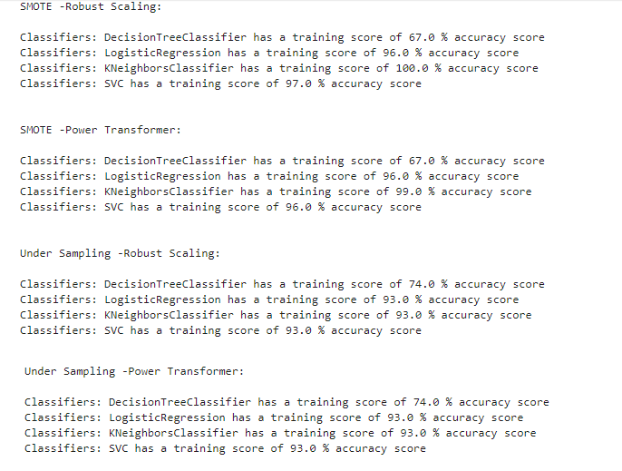
MODEL TRAINING AND REPORT
By machine learning algorithm used to do model training.
We have used Logistic Regression, Decision Tree, and Support Vector Machine in this training.
We have similar result for Robust Scaling and Power Transformer. For a new algorithm, we are using k-NN as well, but we won’t be using it. We can see that k-NN’s accuracy is 100%, and it is highly probable and possible that is suffering from over-fitting.
Random under-sampling has a different result and is not as great as the oversampling results. We can use Decision Tree, Logistic Regression for SMOTE and Support Vector Machine, k-NN for Random Under Sampling.

Slide 18
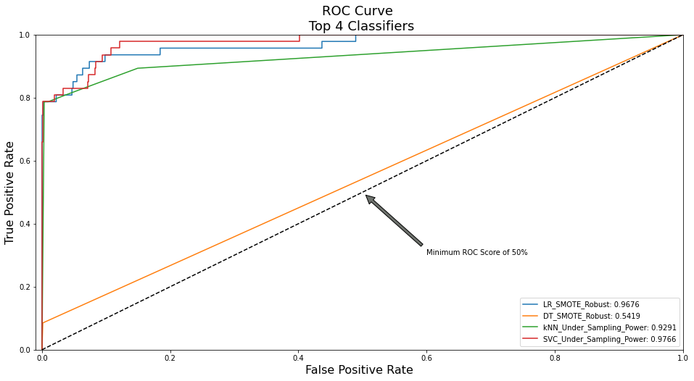
MODEL TRAINING AND REPORT
Next we have generated (Receiver Operating Characteristics ) ROC curve , Precision Curve and Confusion Matrices.
We can see from the score and curve that Decision Tree performed worst hence we can drop that model. The best model as per score is SVC, but we also see a close score to SVC that is of the model Logistic Regression model. Now, both of the models are similar and deciding the right model will be more of a business decision.

Slide 19
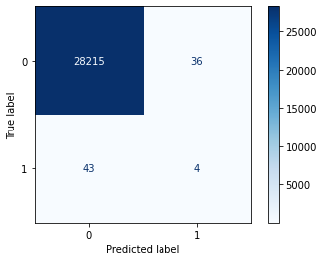

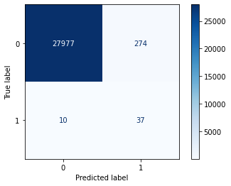

MODEL TRAINING AND REPORT
Reading the matrix we can mostly say all the values of Class 1 , are misclassified and the model is extremely biased towards Class 0. Seeing the performance , we will surely drop DT model and not consider it for further re-tuning.
k-NN was a similar performing model like Logistic Regression and SVC.
We will see the last model’s confusion matrix, which we select as one of the best models.
Fig: Decision Tree Fig: Logistic Regression
Fig: kNN Classifier Fig: SVM Classifier

Slide 20
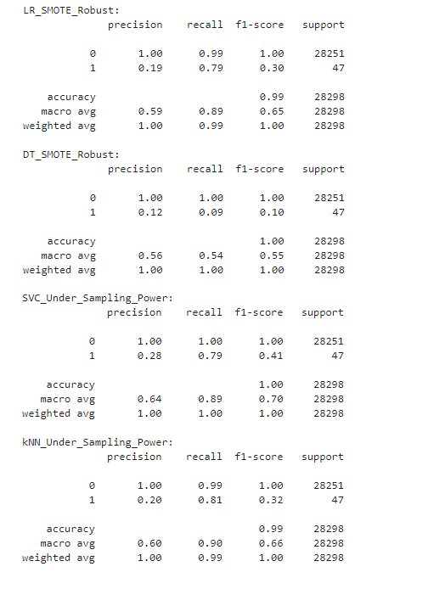
MODEL TRAINING AND REPORT
Next classifier data report is generated.
From the report we can visualize that we need to choose between SVC and Logistic Regression. We can think in the direction of computation time, business logic, convenience and explain-ability to select a model. SVC takes a huge time to compute and it is not advised for extremely large dataset.
Fig: Random Sampling Classification Report.

Slide 21
CONCLUSION
This project help us to deal with large imbalanced dataset.
This project help us to analyze data fraud or not. The exact model will reduce frauds in Credit Card Transaction which is very valuable for financial services , online transactions , ecommerce etc.
-Thank You

